Slide 1
MIAU Project Tracker
User guide

Slide 2
Purpose of this document
This document will demonstrate how to use the project tracker to log live, completed and upcoming projects, as well as how to extract and update information about these projects.

Slide 3
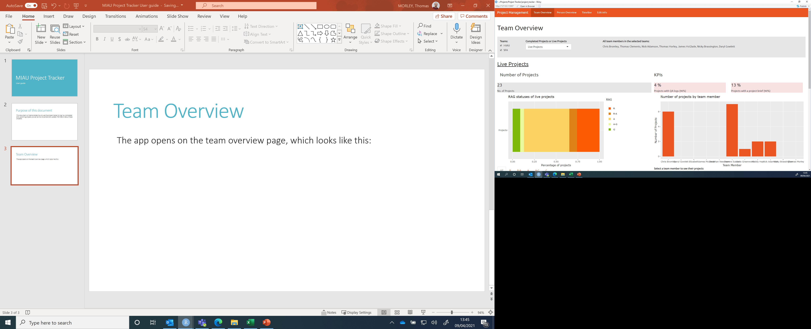
Navigating through the app
The orange bar along the top displays the titles of the different pages. To navigate between the different pages, simply click on the title of the page you want to view.
The app opens on the team overview page, which looks like this:

Slide 4
Team Overview
The bar along the top of the page allows you to select which team you want to look at (as many as you like!) and whether to focus on completed or live projects.

Slide 5
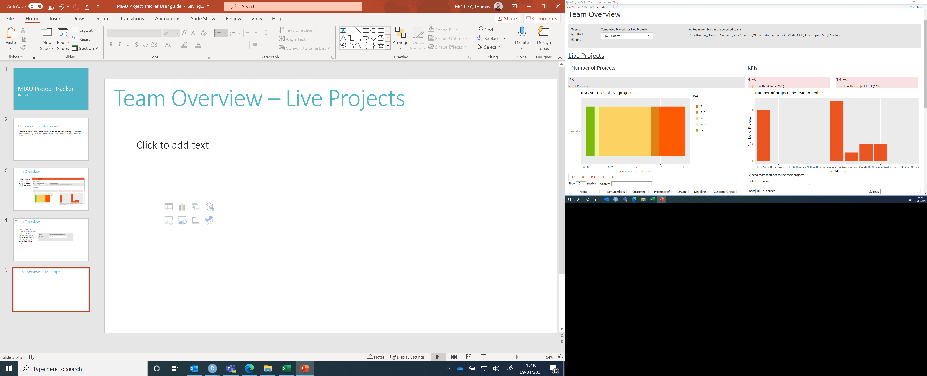
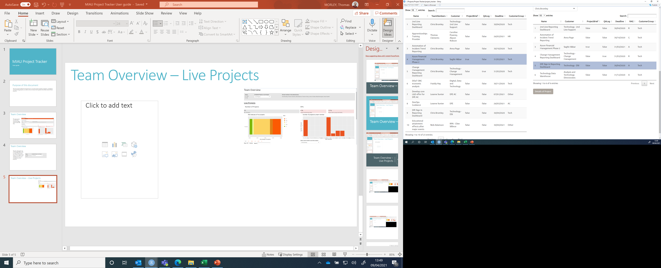
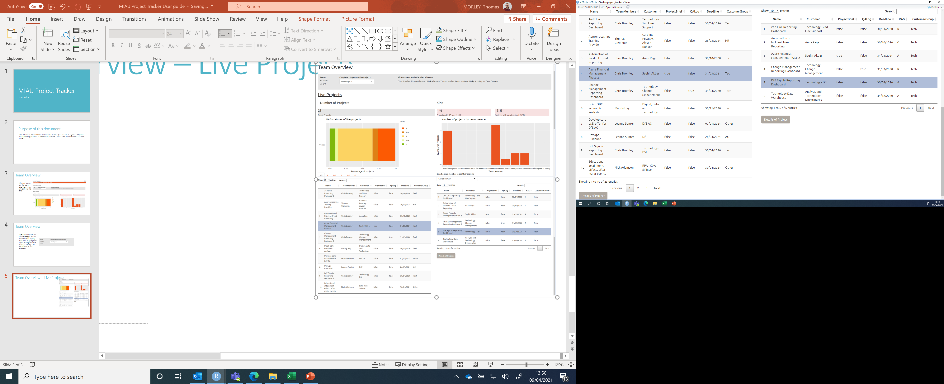
Team Overview – Live Projects
Displays list of current members on the team
Number of live projects
% of projects with QA log/project brief. Colour of box reflects percentage score
Graph displaying percentage of projects by RAG rating
No. of live projects per team member displayed as a bar chart. Names of team members are given along the x-axis.
Select a RAG rating and see all projects with that RAG rating listed below.
Alter number of entries displayed, or click through the pages of entries
Select a team member, and see their live projects listed below.
Click to see more details of each project. Note that this button only appears when a project is highlighted.
Click to see more details of each project. Note that this button only appears when a project is highlighted.

Slide 6
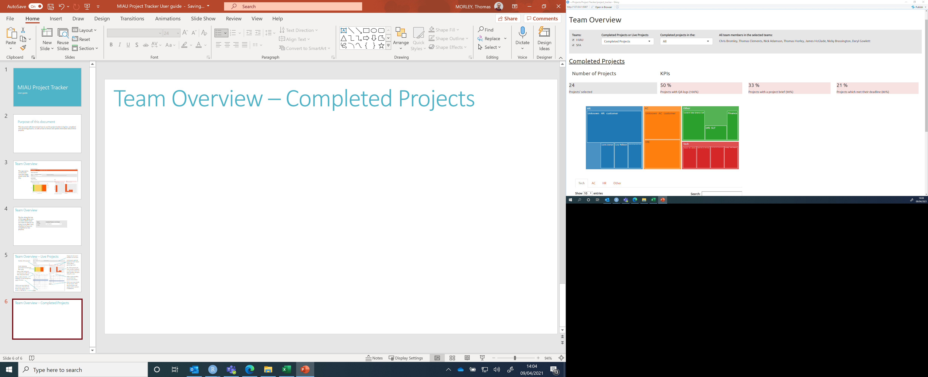
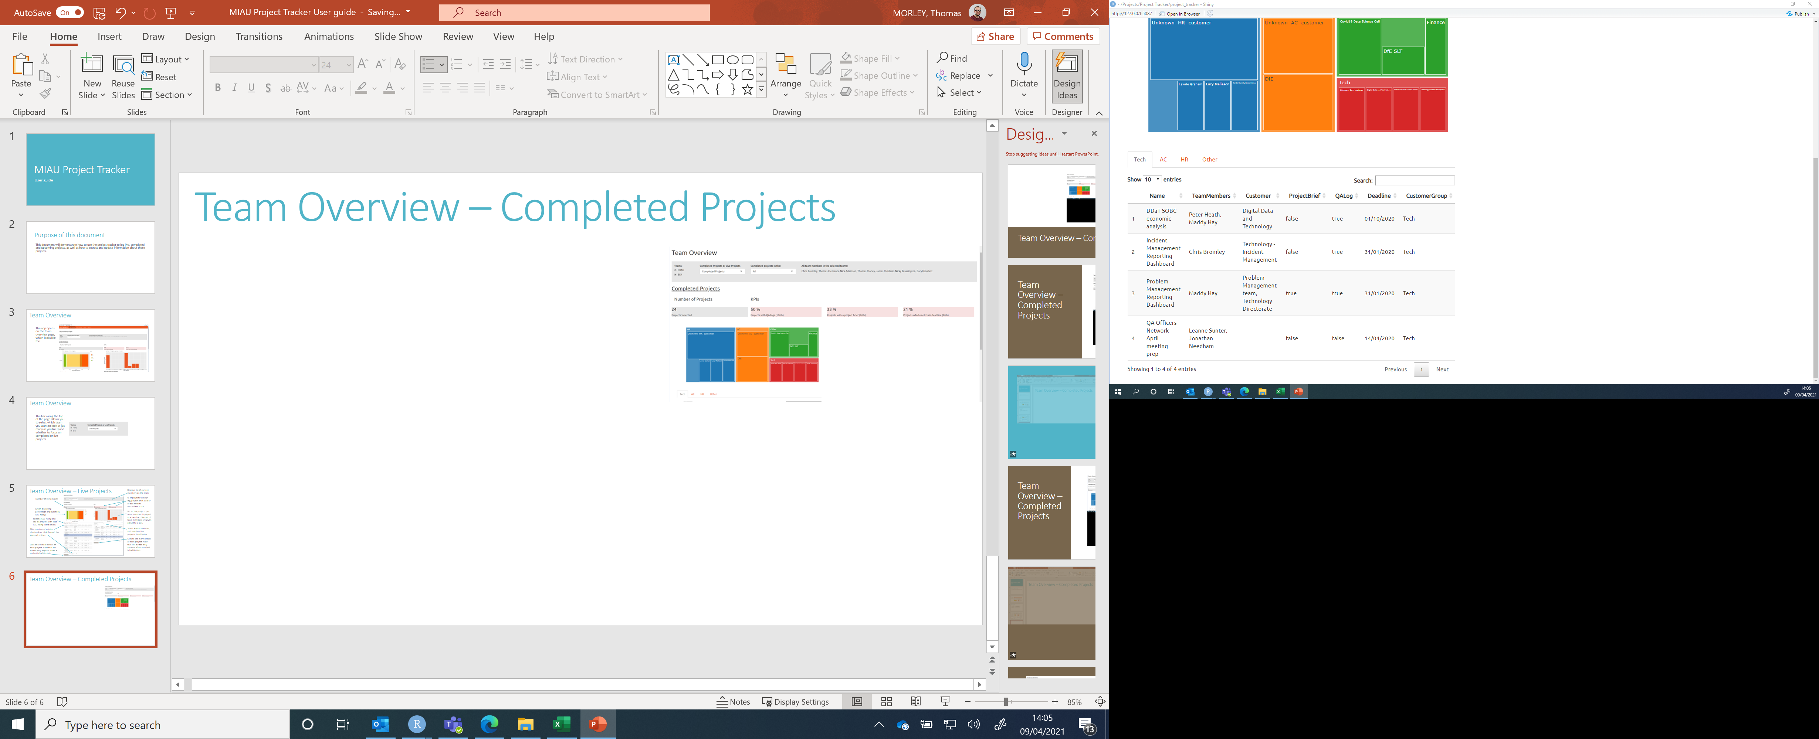
Team Overview – Completed Projects
Select from “Completed Projects in the
Last month
Last 6 months
Last year
Last 3 years
All
% of projects with QA log/project brief/completed on time. Colour of box reflects percentage score
Graph to demonstrate the customers for each project
Number of projects selected
Select the customer group and see all relevant projects displayed below.
The “Details of Project” button will only be displayed if a project is selected!

Slide 7
Team Overview
The bar along the top of the page allows you to select which team you want to look at (as many as you like!) and whether to focus on completed or live projects.

